Slide 1
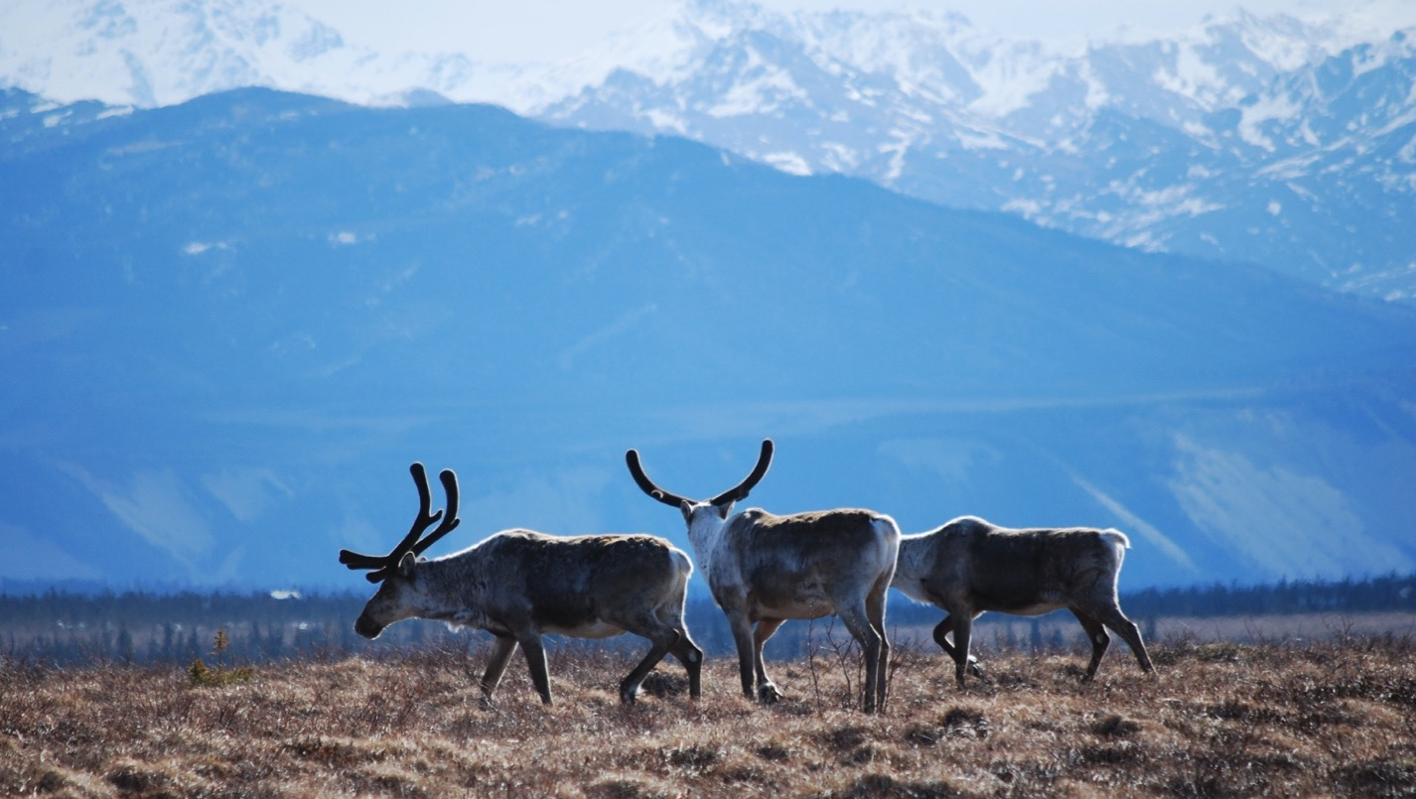
Arctic Boreal Vulnerability Experiment (ABoVE)
2019 ABoVE Airborne Flights
4 July 2019 (DOY 185)
AVIRIS-NG: Toolik Lake, Yukon Flats
Charles Miller, Deputy Science Lead
Jet Propulsion Laboratory, California Institute of Technology
and the ABoVE Science Team
For Hank Margolis, Mike Falkowski, Bruce Tagg, Jack Kaye
NASA HQ
2019

Slide 2

4 July 2019/DOY 185
Toolik Lake – Yukon Flats
Daily Status:
AVIRIS-NG / Dynamic Aviation B-200 (N53W)
REPORT DATE: 4 July 2019
Current Status of Aircraft: GREEN
Current Status of AVIRIS: GREEN
Current Deployment Location: Fairbanks AK (PAFA)
Crew: S Wilson (PIC), C McCann, M Eastwood, L Rios
Science Planning: A Thorpe
Data Processing: W Olsen-Duvall
Instrument Manager: M Eastwood
Instrument PI: R Green
Science Lead: C Miller

Slide 3
4 July 2019/DOY 185
Toolik Lake – Yukon Flats
Daily Summary:
Toolik Lake – Dalton Highway – encountered increasing cloud cover heading north towards Deadhorse, so diverted to Yukon Flats
Most lines 10-50% cloud cover and will need to be retaken; some cloud-free segments may be isolated if needed

Slide 4
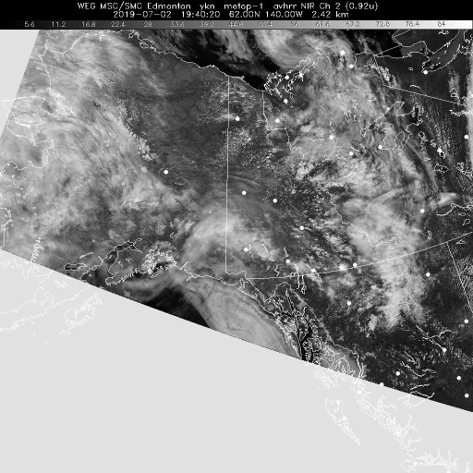
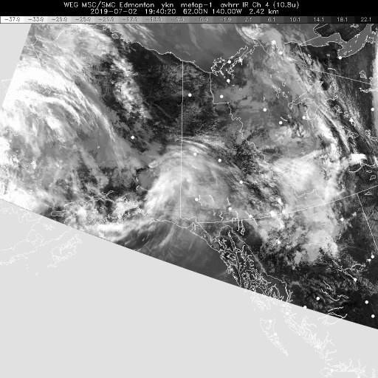
4 July 2019/DOY 185
Toolik Lake – Yukon Flats
Update
Vis 1940Z
IR 1940Z
Satellite imagery shows forecasted high pressure cell west of the Mackenzie Delta
Good conditions over Herschel Island

Slide 5
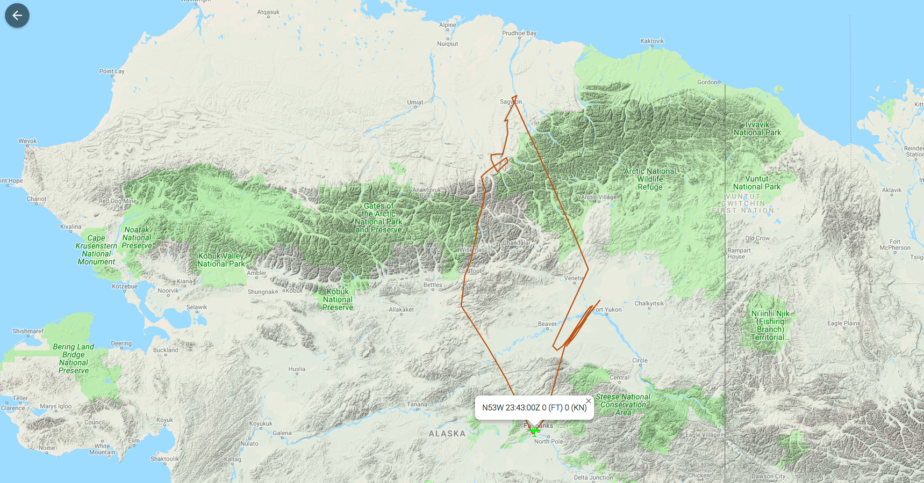
4 July 2019/DOY 185
Toolik Lake – Yukon Flats
As-Flown Lines

Slide 6
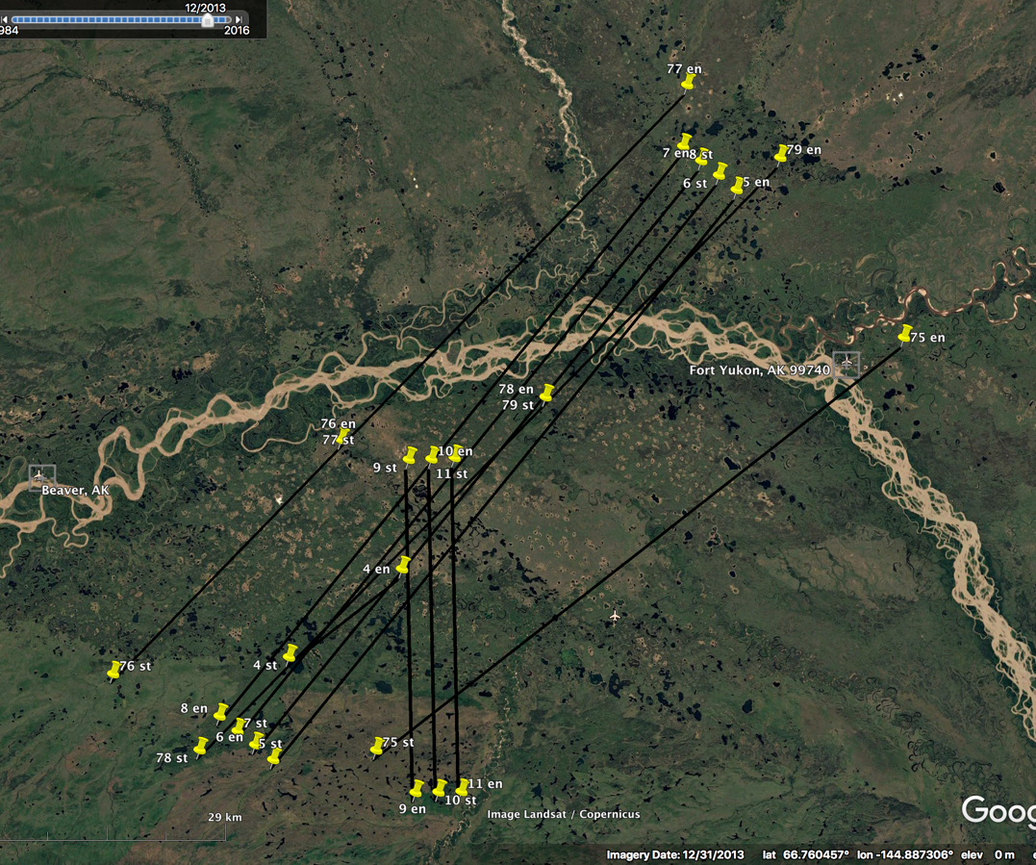
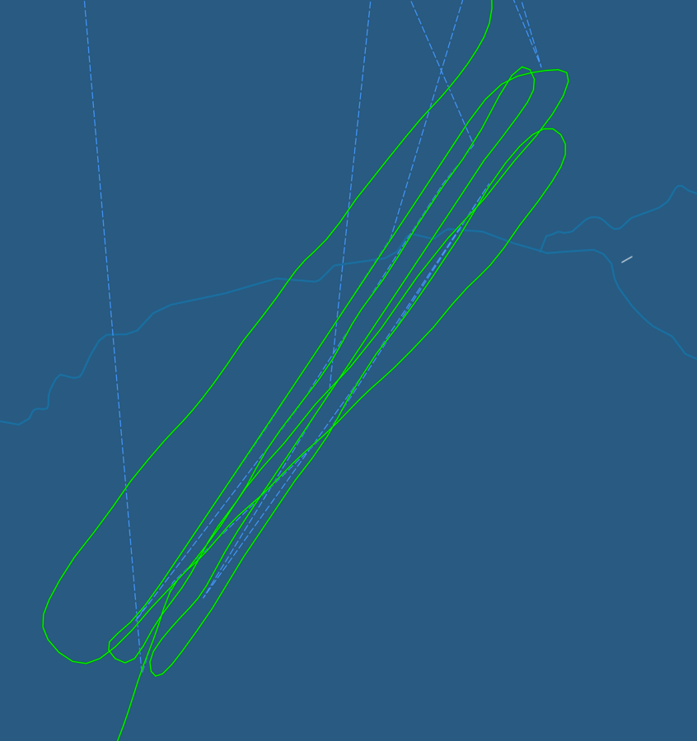
4 July 2019/DOY 185
Toolik Lake – Yukon Flats
Yukon Flats
As-Flown Lines
Yukon Flats
Planned Lines

Slide 7
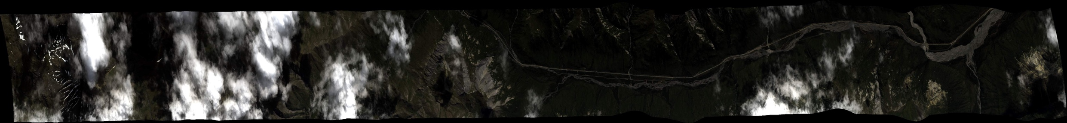
4 July 2019/DOY 185
Toolik Lake – Yukon Flats
AVIRIS-NG Quick-look products
https://avirisng.jpl.nasa.gov/cgi/flights.cgi?step=view_flightlog&flight_id=ang20190704t
A. Line AVng_335D-335Z_FL190 , ang20190704t193319_geo : Coldfoot-Wiseman
B. Line AVng_334A-334Z_FL207 , ang20190704t194936_geo : Anaktuvuk Pass
A
B
A. Cloudy
B. Too cloudy, maybe 50% usable
Notes:
7/19/19 Review
RED
RED

Slide 8
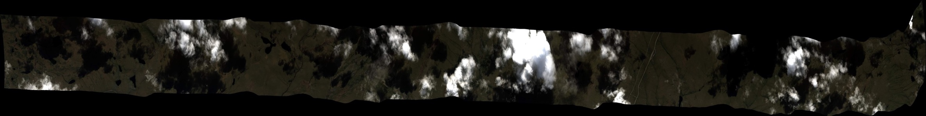
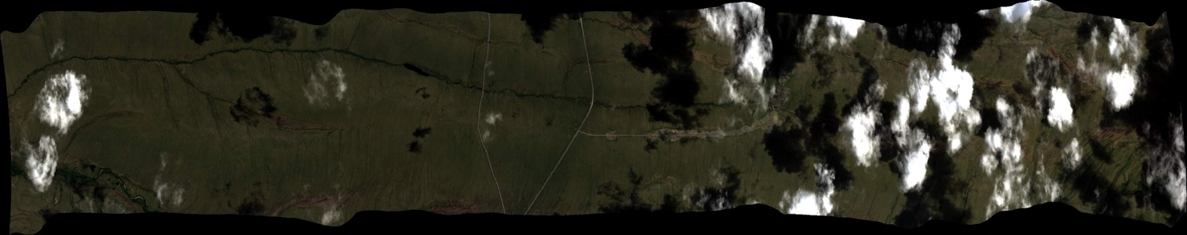
4 July 2019/DOY 185
Toolik Lake – Yukon Flats
AVIRIS-NG Quick-look products
https://avirisng.jpl.nasa.gov/cgi/flights.cgi?step=view_flightlog&flight_id=ang20190704t
A. Line AVng_372A-372Z_FL203 , ang20190704t195946_geo : Toolik Lake/NEON box
B. Line AVng_373A-373Z_FL202 , ang20190704t201036_geo : Toolik Lake/NEON box
A
B
A. Cloudy
B. Partial cloud cover
Notes:
At best these are YELLOW lines
RED, >50% cloud
Yellow/Red – 30% cloud cover, large section usable

Slide 9
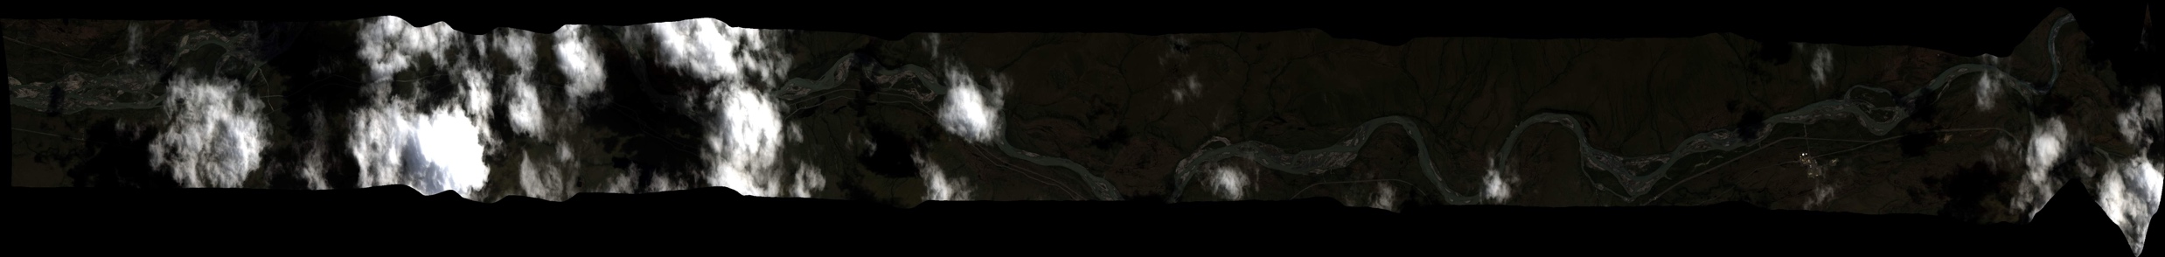
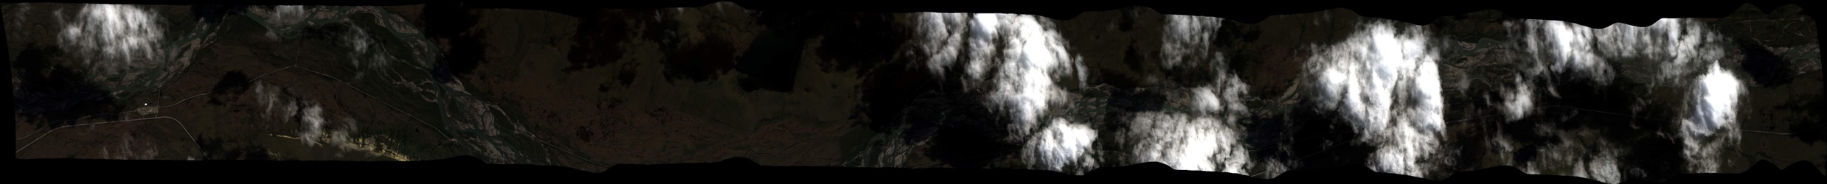
4 July 2019/DOY 185
Toolik Lake – Yukon Flats
AVIRIS-NG Quick-look products
https://avirisng.jpl.nasa.gov/cgi/flights.cgi?step=view_flightlog&flight_id=ang20190704t
A. Line AVng_371A-371Z_FL187 , ang20190704t201715_geo : Imnaviat Creek
B. Line AVng_370A-370Z_FL182 , ang20190704t202628_geo : Dalton Highway
A
B
A. Cloudy
B. Cloud cover increases on right end of swath
Notes:
7/19/19 Review
Yellow/red – 50% cloud
Yellow/red – 50+% cloud cover

Slide 10
4 July 2019/DOY 185
Toolik Lake – Yukon Flats
AVIRIS-NG Quick-look products
https://avirisng.jpl.nasa.gov/cgi/flights.cgi?step=view_flightlog&flight_id=ang20190704t
A. Line AVng_321B-321Z_FL178 , ang20190704t211515_geo : Yukon Flats
B. Line AVng_322A-322B_FL179 , ang20190704t213321_geo : Yukon Flats
A
B
A. Cloud cover increases on right end of swath
B. Cloud cover increases on right end of swath
Notes:
7/19/19 Review
Yellow/green – 20% cloud cover, largely usable
Yellow – 30% cloud cover, largely usable

Slide 11
4 July 2019/DOY 185
Toolik Lake – Yukon Flats
AVIRIS-NG Quick-look products
https://avirisng.jpl.nasa.gov/cgi/flights.cgi?step=view_flightlog&flight_id=ang20190704t
A. Line BirchCrkN_L004_FL179 , 215004: Yukon Flats
B. Line BirchCrkN_L003_FL179 , ang20190704t220610_geo : Yukon Flats
A
Quicklook in process
B
A. N/A
B. Cloud cover increases on right end of swath
Notes:
Review 7/19/19
Yellow based on log info
Yellow – 20% clouds

Slide 12
4 July 2019/DOY 185
Toolik Lake – Yukon Flats
AVIRIS-NG Quick-look products
https://avirisng.jpl.nasa.gov/cgi/flights.cgi?step=view_flightlog&flight_id=ang20190704t
A. Line BirchCrkN_L002_FL179 , ang20190704t222130_geo : Yukon Flats
B. Line BirchCrkN_L001_FL179 , ang20190704t223716_geo : Yukon Flats
A
B
A. N/A
B. Cloud cover increases on right end of swath
Notes:
7/19/19 Review
Yellow – 20% cloud
Yellow – 20% cloud

Slide 13
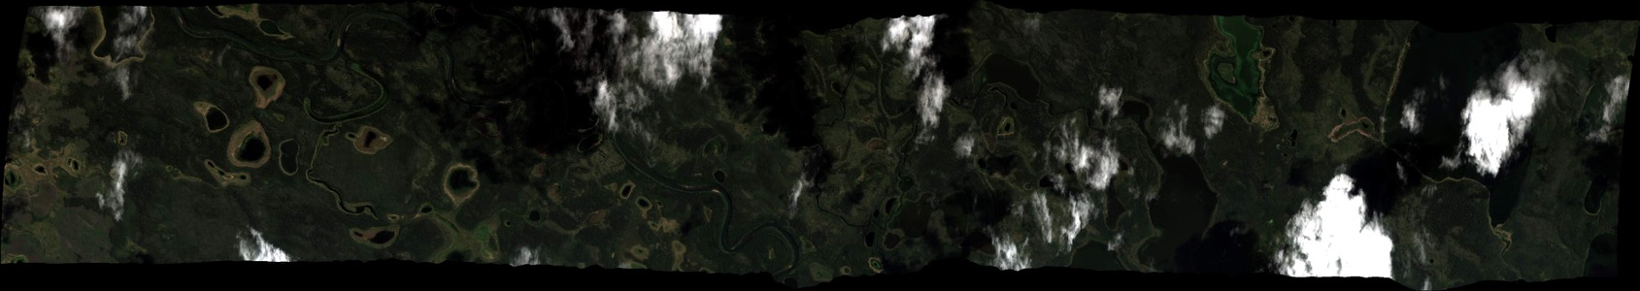
4 July 2019/DOY 185
Toolik Lake – Yukon Flats
AVIRIS-NG Quick-look products
https://avirisng.jpl.nasa.gov/cgi/flights.cgi?step=view_flightlog&flight_id=ang20190704t
A. Line AB_CH4_L008_FL072 , ang20190704t230104_geo : Yukon Flats
A
B
A. Partial cloud cover
Notes:
Review 7/19/19
A. Yellow – 20% scattered cloud cover

Slide 14
Backup

Slide 15
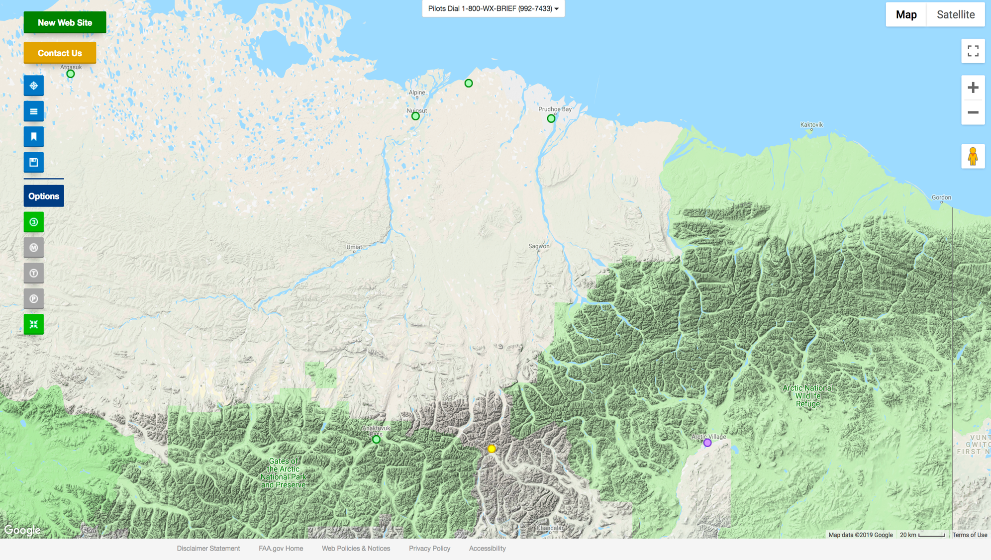
FAA Camera Locations

Slide 16
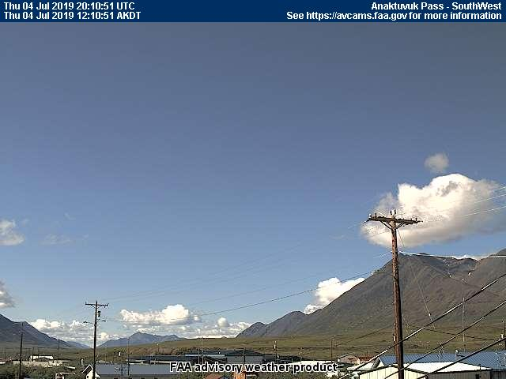
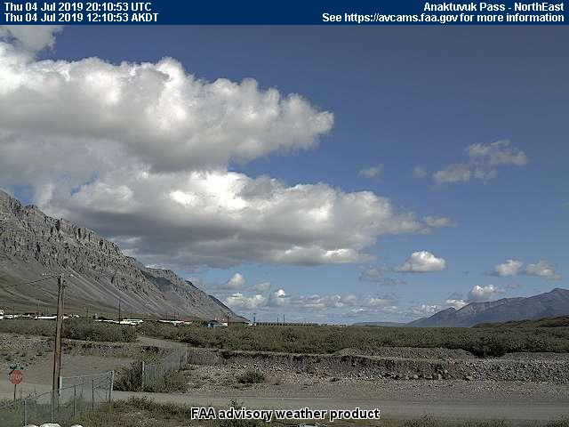
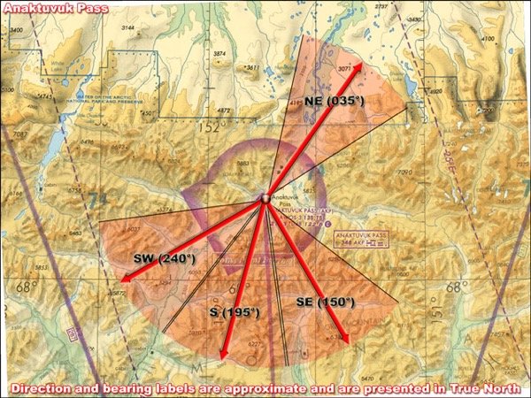
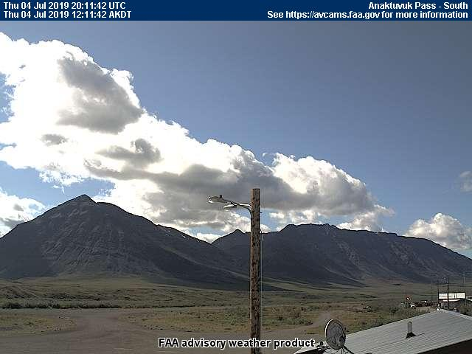
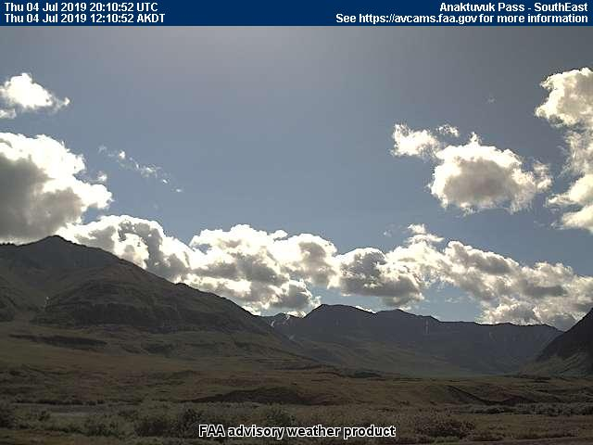
4 July 2019/DOY 185
Toolik Lake – Yukon Flats
Anuktuvuk Pass – 1210 AKDT/2010 UTC

Slide 17
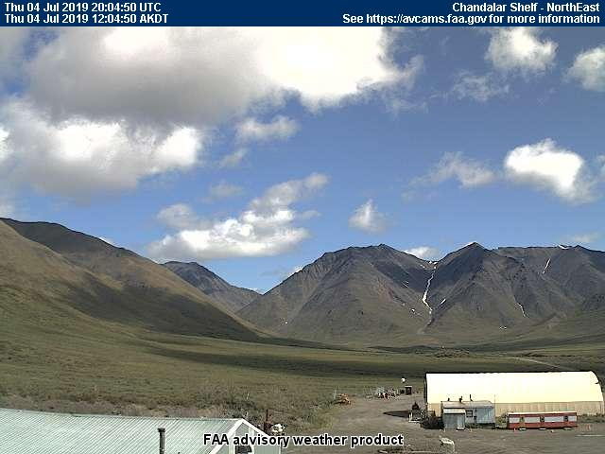
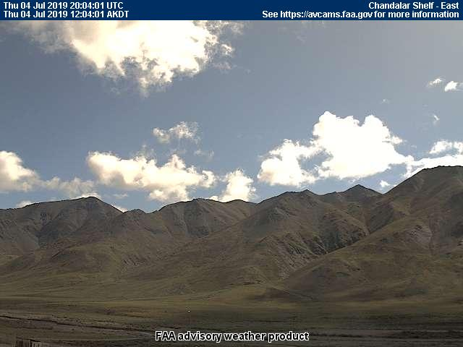
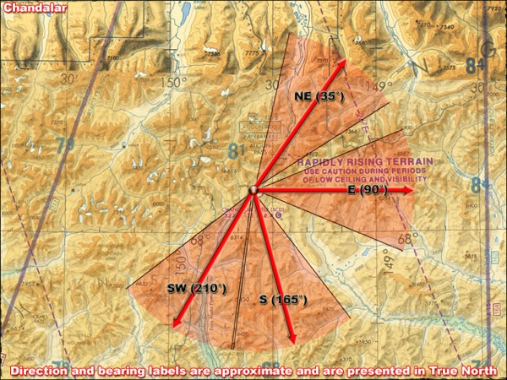
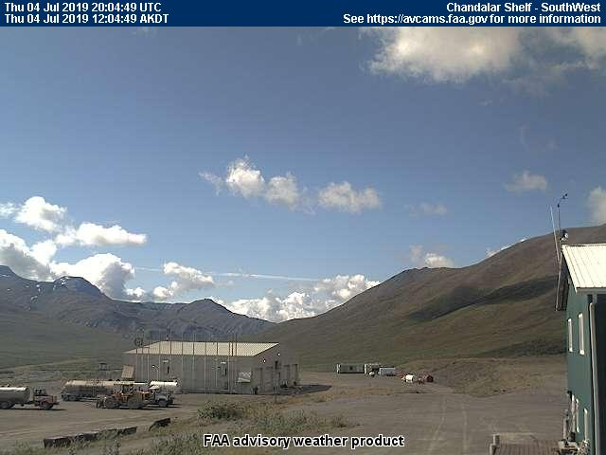
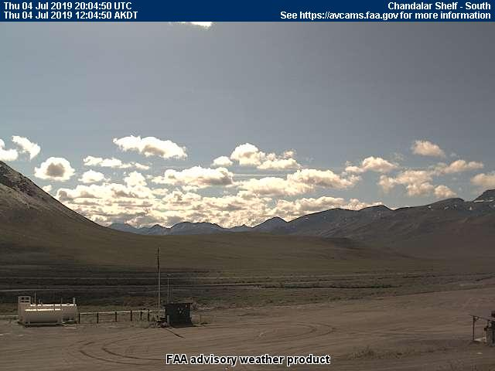
4 July 2019/DOY 185
Toolik Lake – Yukon Flats
Chandalar Shelf – 1310 AKDT/2110 UTC

Slide 18
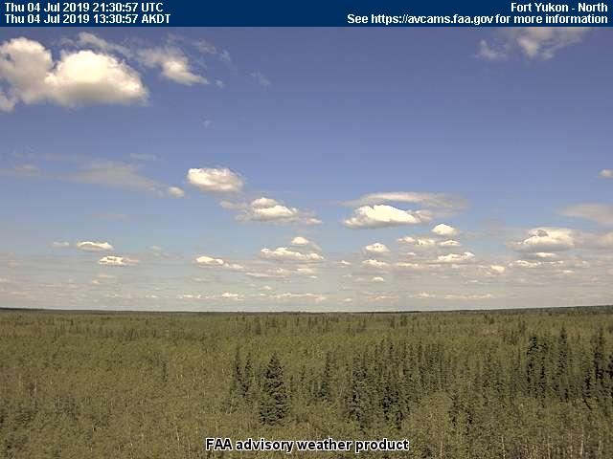
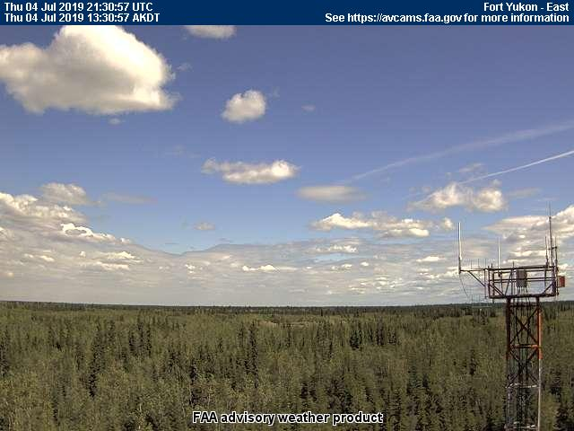
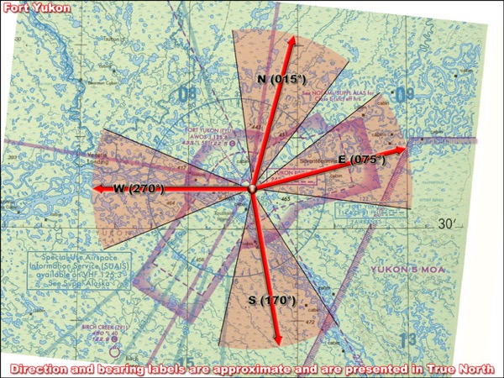
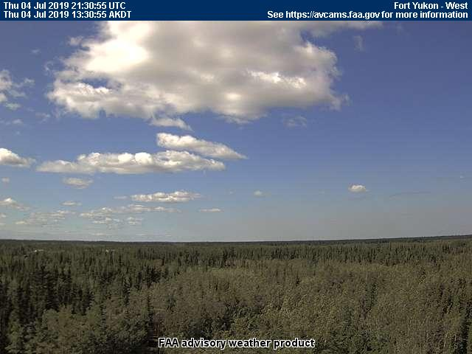
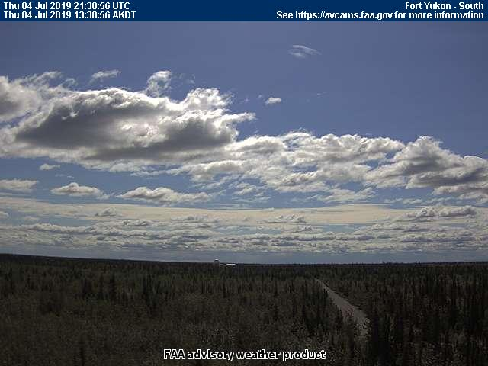
4 July 2019/DOY 185
Toolik Lake – Yukon Flats
Fort Yukon – 1330 AKDT/2130 UTC

Slide 19
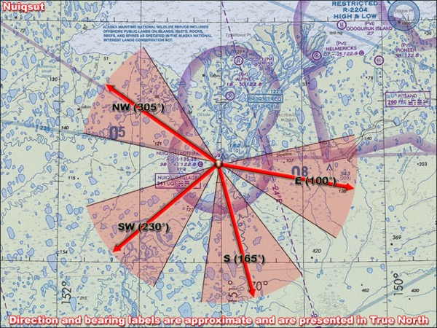
4 July 2019/DOY 185
Toolik Lake – Yukon Flats
Nuiqsut – 1310 AKDT/2110 UTC

Slide 20
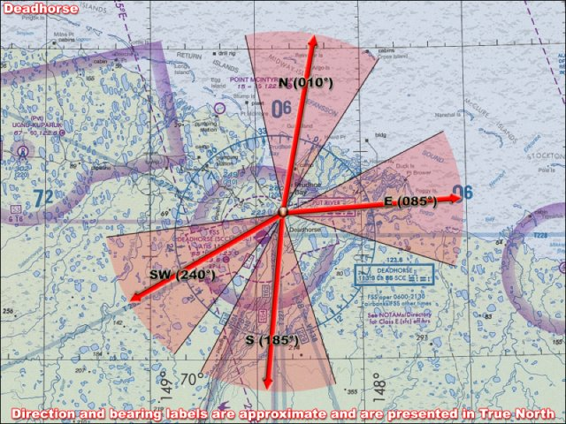
4 July 2019/DOY 185
Toolik Lake – Yukon Flats
Deadhorse – 1310 AKDT/2110 UTC

